Slide 1
CSYE 7374
Design Patterns
Notes:
1.001

Slide 2
Builder Design Patterns
Daniel Peters
d.peters@neu.edu

Slide 3
Lecture
UML
Design Patterns:
Gang of Four (GoF)
Builder Pattern

Slide 4
Relationships
5/21/2020
Association
Aggregation
“Has-A”
Composition
“Has-A”
Generalization
Inheritance
“Is-A”

Slide 5
Association Relationship
5/21/2020
Association: Has-A Relationship
Aggregation
Weak association: linked but independent objects
possessed object can survive after possessing object
Line with open arrowhead outline
Composition
Strong association: linked objects are dependent
possessed object is destroyed along with possessing object
Line with solid filled-in arrowhead

Slide 6
Aggregation Association Relationship
1..*
1
10..*
1
1
1
6/12/2020
Weak Independent Aggregation Association
Teacher Classroom
Student School
Driver Automobile
Teachers can continue to exist without Classroom
Student existence independent of School
Driver can get another Automobile

Slide 7
Composition Association Relationship
2
1
1
1
1
1
6/12/2020
Strong Dependent Composition Association
Eyes Body
State Context
AutoState Automobile
The Automobile State (AutoState) is dependent on existence of the Automobile

Slide 8
Relationships
9/7/2015
Generalization
Parent
Child

Slide 9
UML Class Diagram
Class
Attributes
Operations
9/7/2015

Slide 10
UML Class Diagram
ClassName
- private
- Attribute1 : int
- Attribute2 : String
+ public
+ Operation1() : int
+ Operation2(int) : void
9/7/2015

Slide 11
Person Class Diagram
Person
- age : int
- name : String
+ setAge(int) : void
+ getAge() : int
+ setName(String) : void
+ getName() : String
Employee
Student
- hours: int
- grade : int
+ setHours(int) : void
+ getHours() : int
+ setGrade(int) : void
+ getGrade() : int
9/7/2015

Slide 12
Builder Class Diagram
BuilderAPI
Builder1
Builder2
9/7/2015

Slide 13
Design Patterns
Gang of Four (GoF) Book
Design Patterns
Elements of Reusable Object-Oriented Software
by Erich Gamma, Richard Helm, Ralph Johnson John Vlissides
ISBN-10: 0201633612
ISBN-13: 9780201633610

Slide 14
Creational Design Patterns
Abstracts the instantiation (object creation) process
Replaces class constructor
Supports system independence from object creation, composition and representation details
Inheritance and Object Composition
Subclasses are instantiated
New Objects are composed
Gang of Four (GoF) Book

Slide 15
Creational Design Patterns
Creational class patterns
Use Inheritance to vary the class instantiated, e.g., Factory pattern
Creational object patterns
Delegates instantiation to another object, e.g., Builder, Prototype pattern
Gang of Four (GoF) Book

Slide 16
Builder Design Pattern
Builder Pattern is a Structural Pattern in GoF Design Patterns Book:
“Separate the construction of a complex object from the representation so that the same construction process can create different representations."
Facilitates translation
Delegates conversion and building to subsystem
Gang of Four (GoF) Book

Slide 17
Builder Design Pattern
Anatomy of a Design Pattern
Who (are): Constituent Components (parts)
What (happens): Operational
Where (useful): Scenarios
Why (design) Rationale
When (used): Benefits

Slide 18
Builder Design Pattern
Who:
Constituent components, roles or parts participating in the deployment and use of the Builder pattern
Client
Knows which representation to request
Director
Uses the builder abstractly to build
Builder API for all Builder subclasses
Builder subclasses
Provides the specialized functionality
Performs work requested of Director

Slide 19
Builder Design Pattern
What:
A brief description of what happens with the use of the Builder pattern
Client configures the Director with a specific Builder
Director does his part but calls Builder repeatedly for specific building
Client retrieves specific result from Builder
Builder API provides loose coupling to Builder subclasses

Slide 20
Builder Design Pattern
Where:
A list of suitable scenarios for the use of the Builder pattern
Builder pattern works well where:
Building requires multiple representations

Slide 21
Builder Design Pattern
Why:
A brief description of rationale behind the design of the Builder pattern
Keeping all complexity in a single class is bad practice, difficult to maintain and costly to expand
List of complicated subclasses would grow
Interchangeable Specialized builder subclasses can be used abstractly to provide a single director class with all the varied functionality a client may request.

Slide 22
Builder Design Pattern
When:
A brief description of the benefits obtained when using the Builder pattern
Abstraction: hides Builder creation details
Simplification achieved while promoting loose coupling
Director class maintains common functionality
Flexibility: Client can request the specific functionality needed and configure Director as needed.

Slide 23
Builder Pattern
5/11/2020
Builders Implement client requested functionality
New Builders may be added in the future
Director’s general functionality is common denominator and extended by a Builder
Hides Builder complex subsystem details
Director class maintains a single responsibility

Slide 24
Summary: Builder Pattern
Builder: Object creation specifics
Creational Pattern

Slide 25
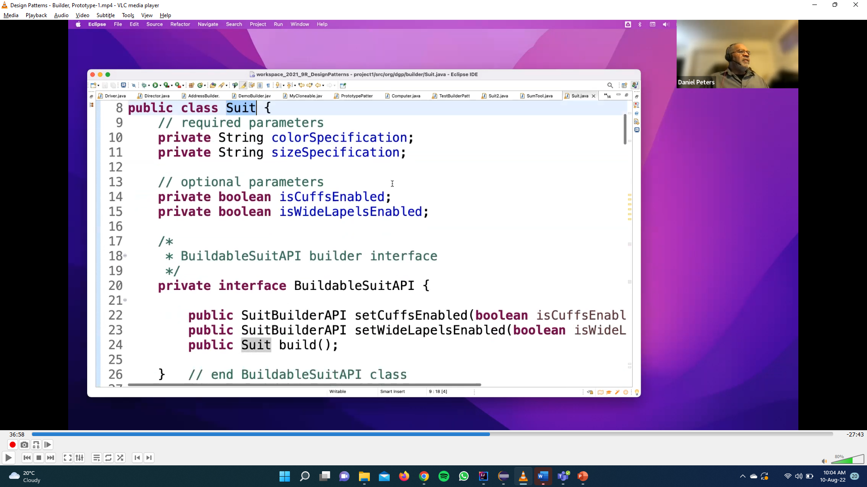
Builder Code-1

Slide 26
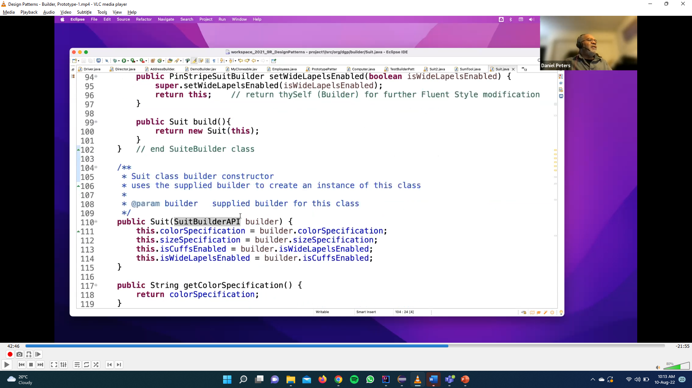
Builder Code-1

Slide 27
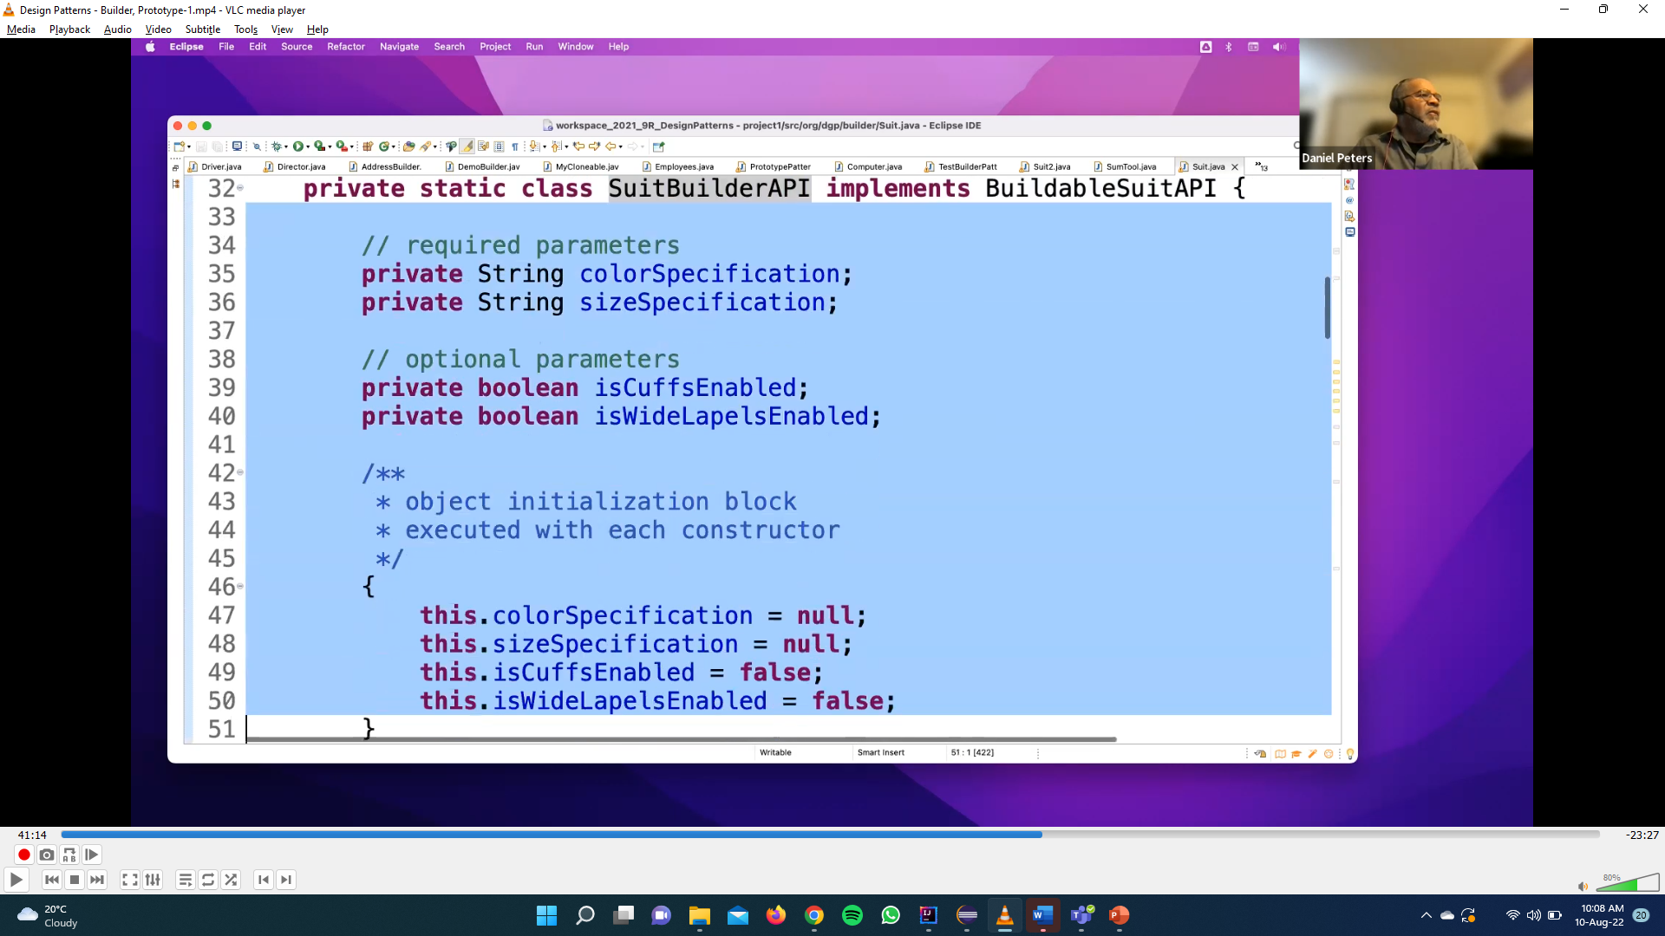
Builder Code-1

Slide 28
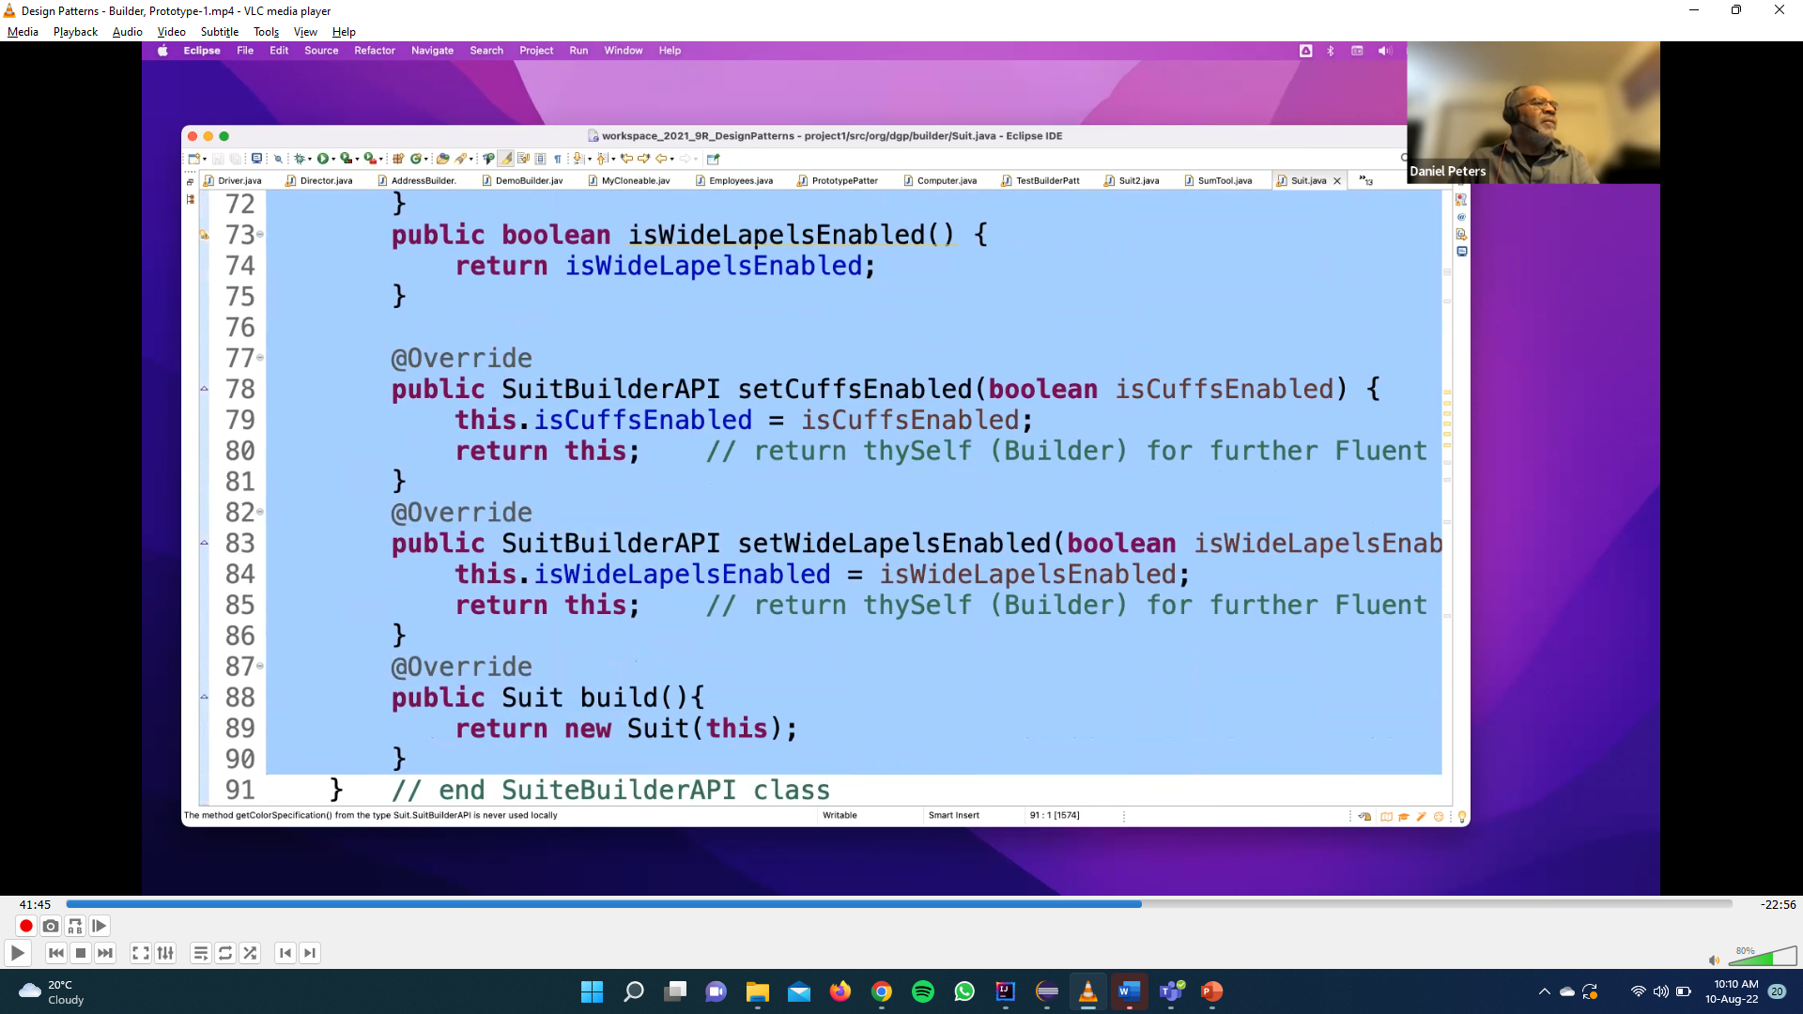
Builder Code-1

Slide 29
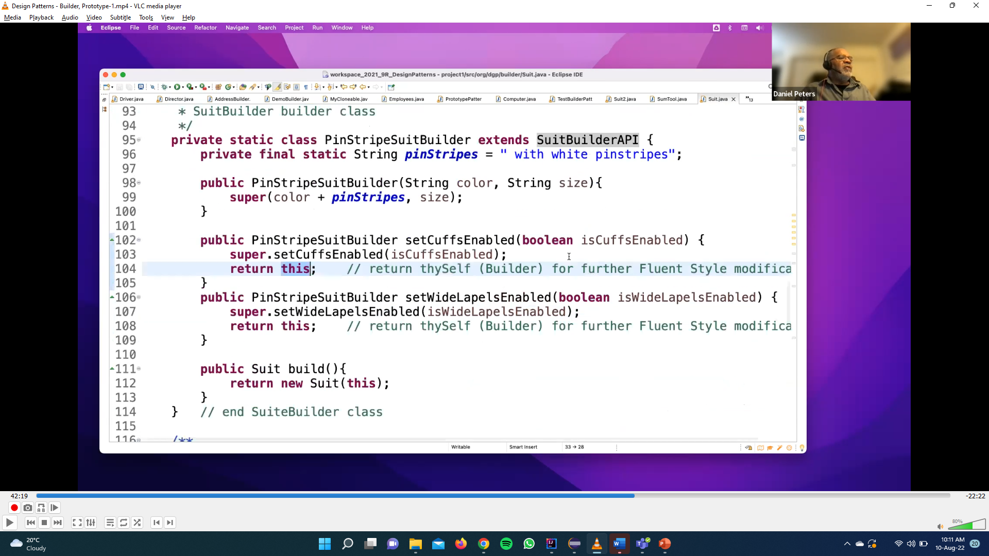
Builder Code-1

Slide 30
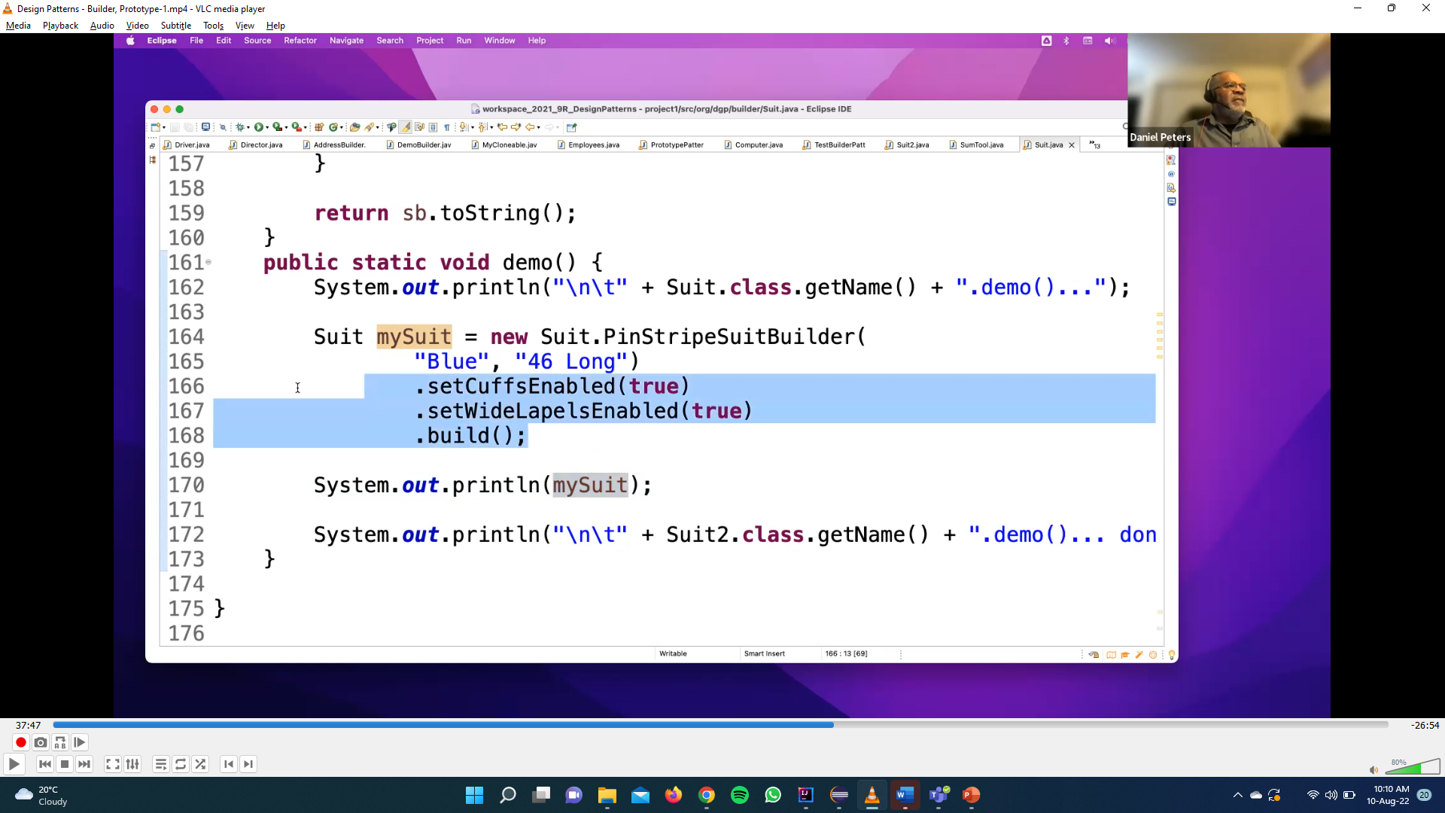
Builder Code-1

